Slide 1

Project Title – Seasonal Agricultural Performance Analysis
Name : Melisha Lewis
College Name : NMAM Institute of Technology
AICTE STU ID : STU6a1acf305be631780141872

Slide 2

PROBLEM STATEMENT
Agricultural performance varies across seasons due to changes in environmental conditions, farming practices, resource availability, and market factors. This project aims to analyze and compare agricultural performance across different seasons by identifying patterns and trends in crop yield, resource usage, and economic performance, helping to support better agricultural planning, efficient resource management, and improved farming decisions.

Slide 3
Project Description
This project analyzes agricultural performance across different seasons using data on crop production, environmental conditions, farming practices, resource usage, and economic factors. The dataset is cleaned and explored using statistical and visualization techniques to compare seasonal performance, identify patterns and trends, and study relationships between important agricultural factors. The analysis provides insights into crop yield, water usage, costs, revenue, and profit, helping in better agricultural planning and resource management.

Slide 4

WHO ARE THE END USERS?
The main end users of this project are farmers, agricultural researchers, agricultural planners, government agencies, and agribusiness organizations. The insights can help them understand seasonal crop performance, optimize resource usage, and make better decisions regarding agricultural planning and management.

Slide 5
Technology Used
Python – Data analysis and processing
Pandas – Data cleaning and manipulation
NumPy – Numerical computations
Matplotlib & Seaborn – Data visualization
Jupyter Notebook – Analysis and presentation of results
CSV Dataset – Seasonal Agriculture Performance Dataset

Slide 6
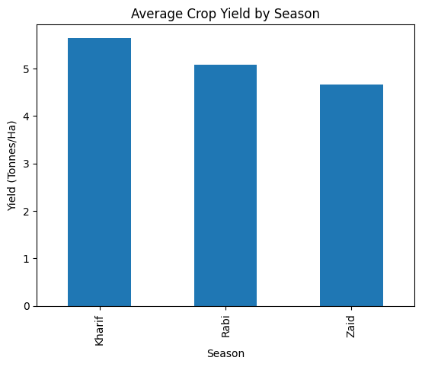
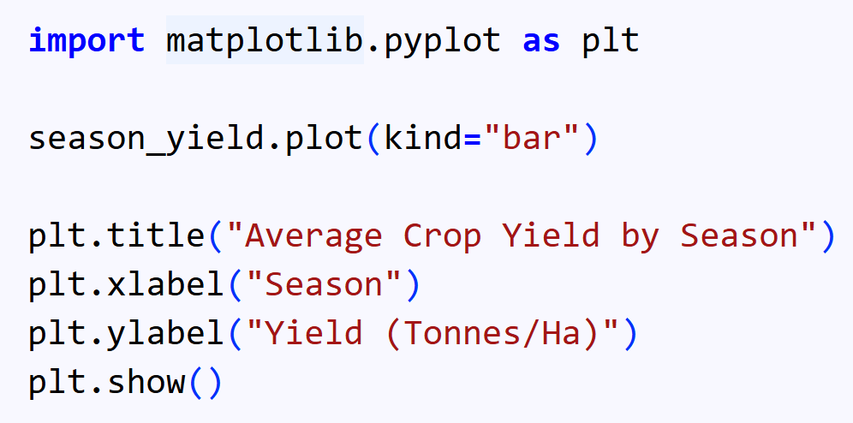
RESULTS

Slide 7
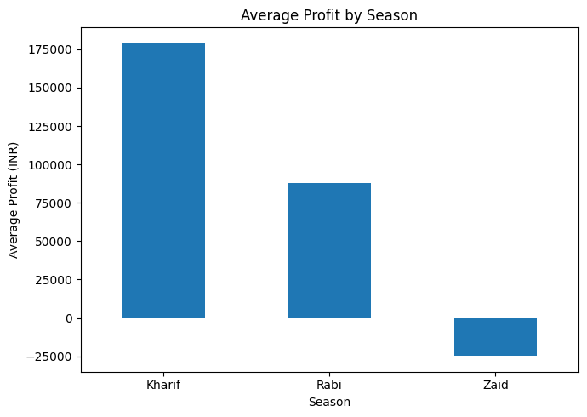
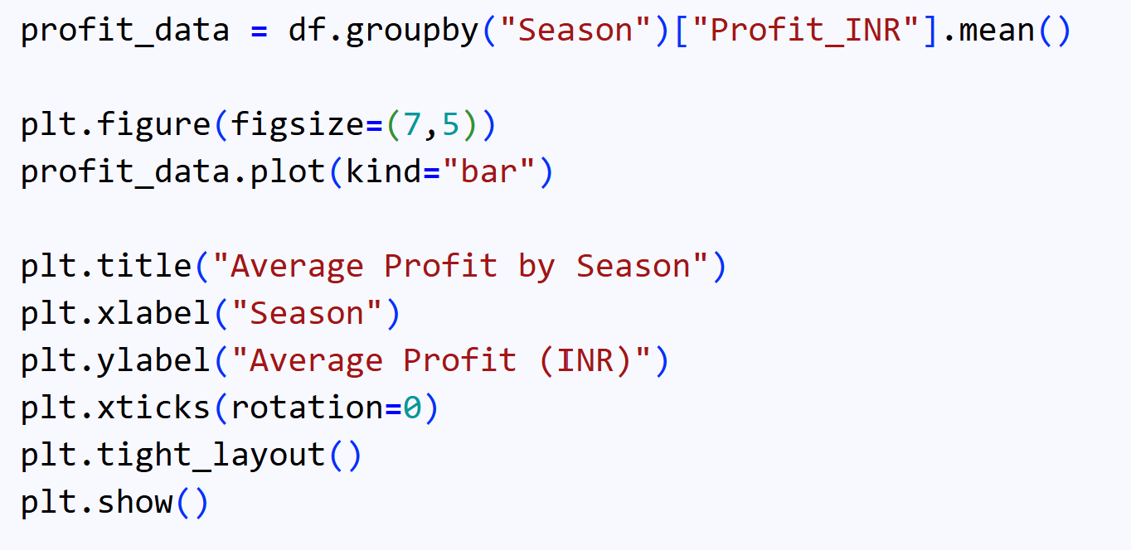
RESULTS

Slide 8
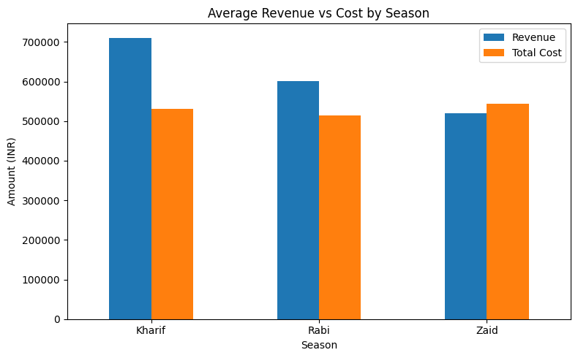
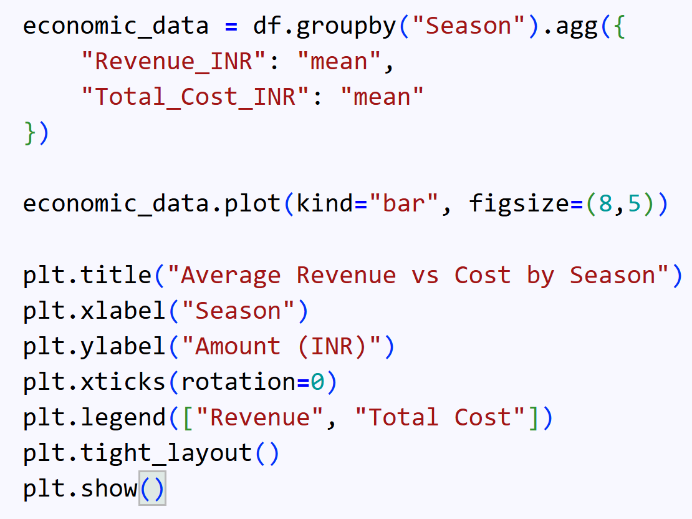
RESULTS

Slide 9
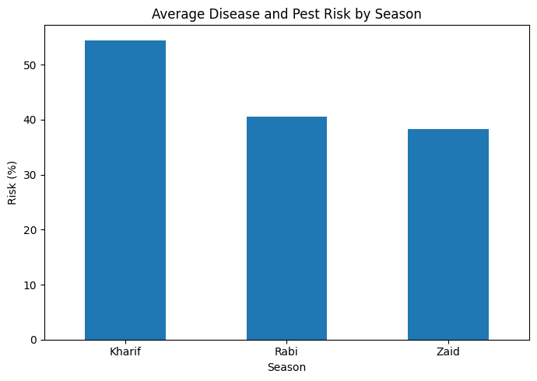
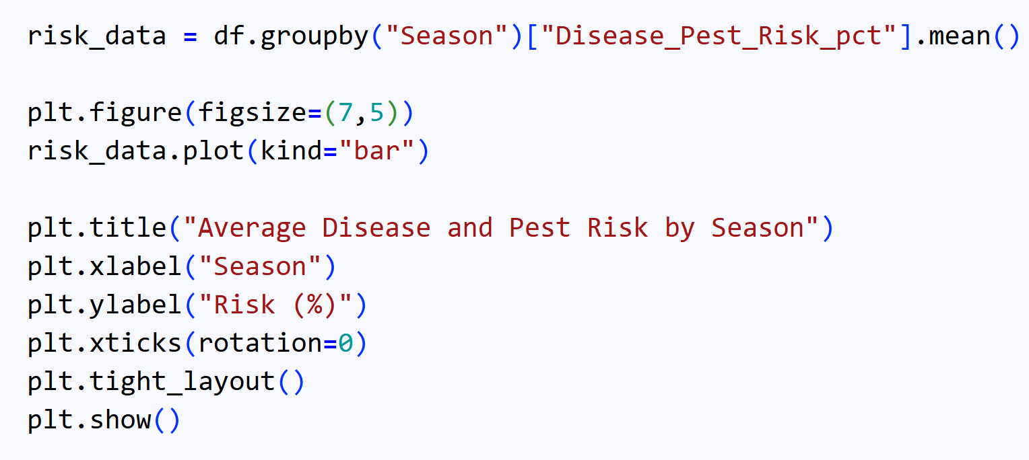
RESULTS

Slide 10
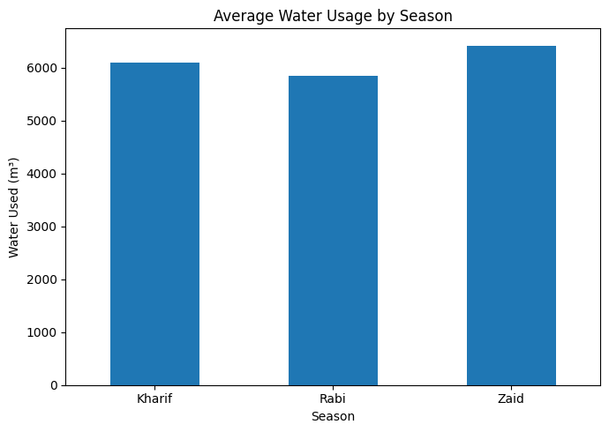
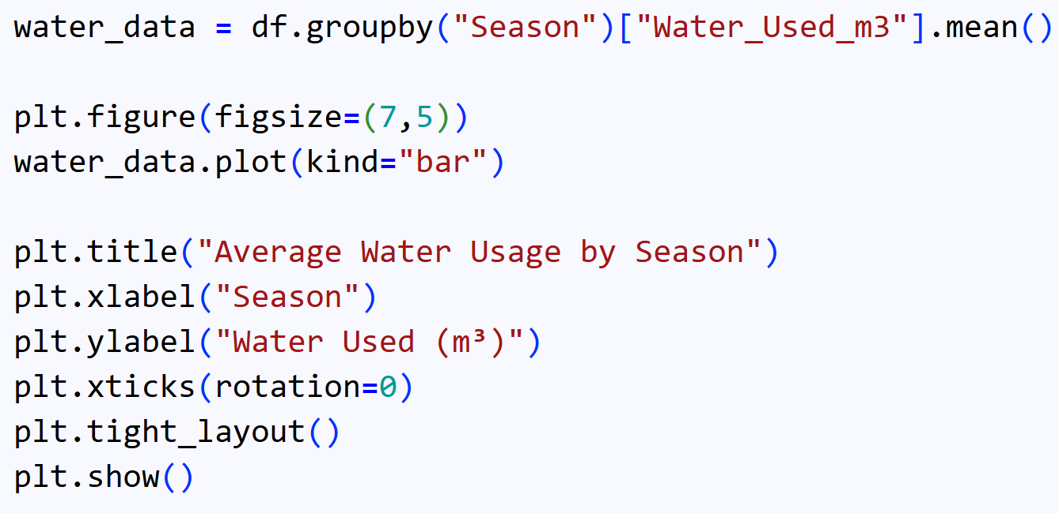
RESULTS

Slide 11
Future scope
The project can be further enhanced by integrating real-time agricultural data, weather and soil information, and advanced machine learning models to predict crop yield and profitability. A recommendation system could also be developed to suggest suitable crops, optimal resource usage, and farming strategies for each season. This can help farmers and agricultural planners make more accurate, data-driven decisions.

Slide 12
GitHub Link
https://github.com/melisha-lewis/Seasonal_Agricultural_Performance_Analysis.git

Slide 13

VOIS Course completion certificate -
Course name- Data Visualization

Slide 14
Thank you
.
.

